Slide 1
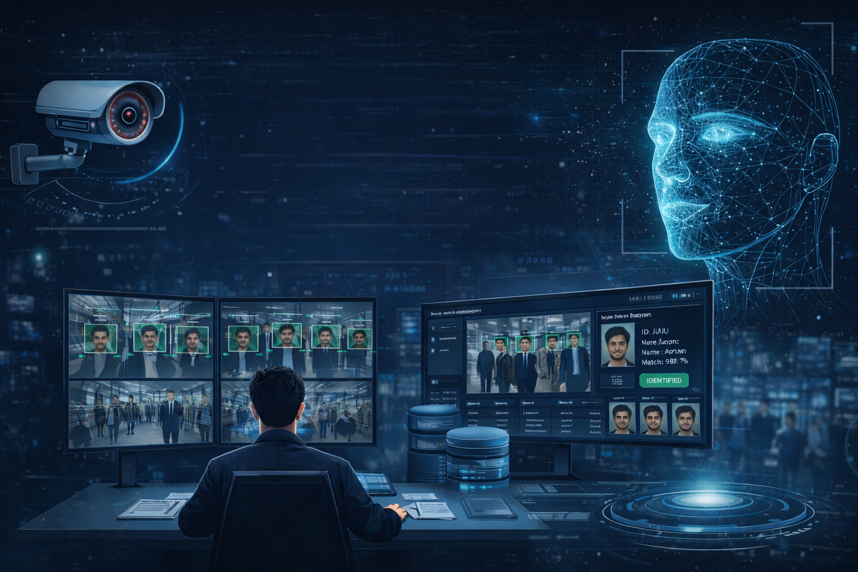
UNIVERSITY VIDEO PRESENCE ANALYSIS SYSTEM USING FACE RECOGNITION
GUIDED BY
Dr. M. K. NAGARAJAN

Slide 2

TEAM MEMBERS
BUCHUPALLI LALITHADITHYA REDDY - 99220041142
CHAMANTHULA SHIVA KUMAR – 99220041150
BAIRAJU NAVEEN CHANDRA – 99220041118
CHANDRAGIRI MOHAMMAD ASHRAF – 99220041151

Slide 3
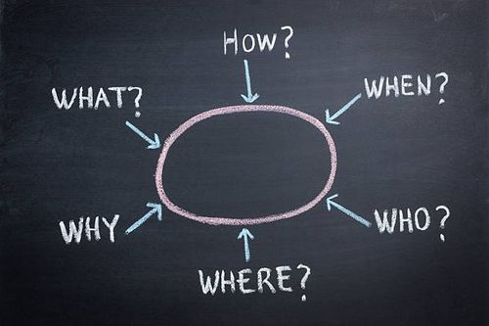
PROBLEM STATEMENT
In today's world, CCTV cameras are widely used for surveillance in public places, institutions, and organizations. These cameras continuously record large amounts of video data, making manual monitoring difficult and time-consuming. Security personnel must watch multiple screens for long hours, which increases the chances of human error and missing important events.
Traditional CCTV systems only record video footage but do not provide intelligent analysis or automatic identification of individuals. When a specific person needs to be identified, it requires manually searching through hours of video, which is inefficient and slow. This process becomes more challenging in crowded environments where multiple faces appear simultaneously.
Therefore, there is a need for an automated system that can detect and recognize faces from CCTV footage. The system should compare detected faces with a stored database and display the identified person's details. This will reduce manual effort, improve accuracy, enhance security, and enable faster identification in surveillance systems.

Slide 4

LITERATURE REVIEW
Face recognition has become an important research area in computer vision and surveillance systems. Many researchers have proposed different methods to detect and recognize faces from images and video streams. Traditional face recognition techniques used algorithms such as Eigenfaces, Fisher faces, and Local Binary Patterns (LBP). These methods worked well in controlled environments but showed poor performance under variations in lighting, pose, and facial expressions.
With the advancement of deep learning, Convolutional Neural Networks (CNNs) significantly improved face recognition accuracy. Models such as DeepFace, FaceNet, and VGG-Face introduced embedding-based face recognition, where facial features are converted into numerical vectors and compared using distance metrics. Among these, FaceNet provides high accuracy and better performance for real-time recognition.
Recent surveillance systems use deep learning-based face detection and recognition for security applications. These systems detect faces from CCTV footage, extract facial features, and compare them with stored databases. However, many existing systems focus only on detection and recognition, without providing an interactive interface to display person details.

Slide 5
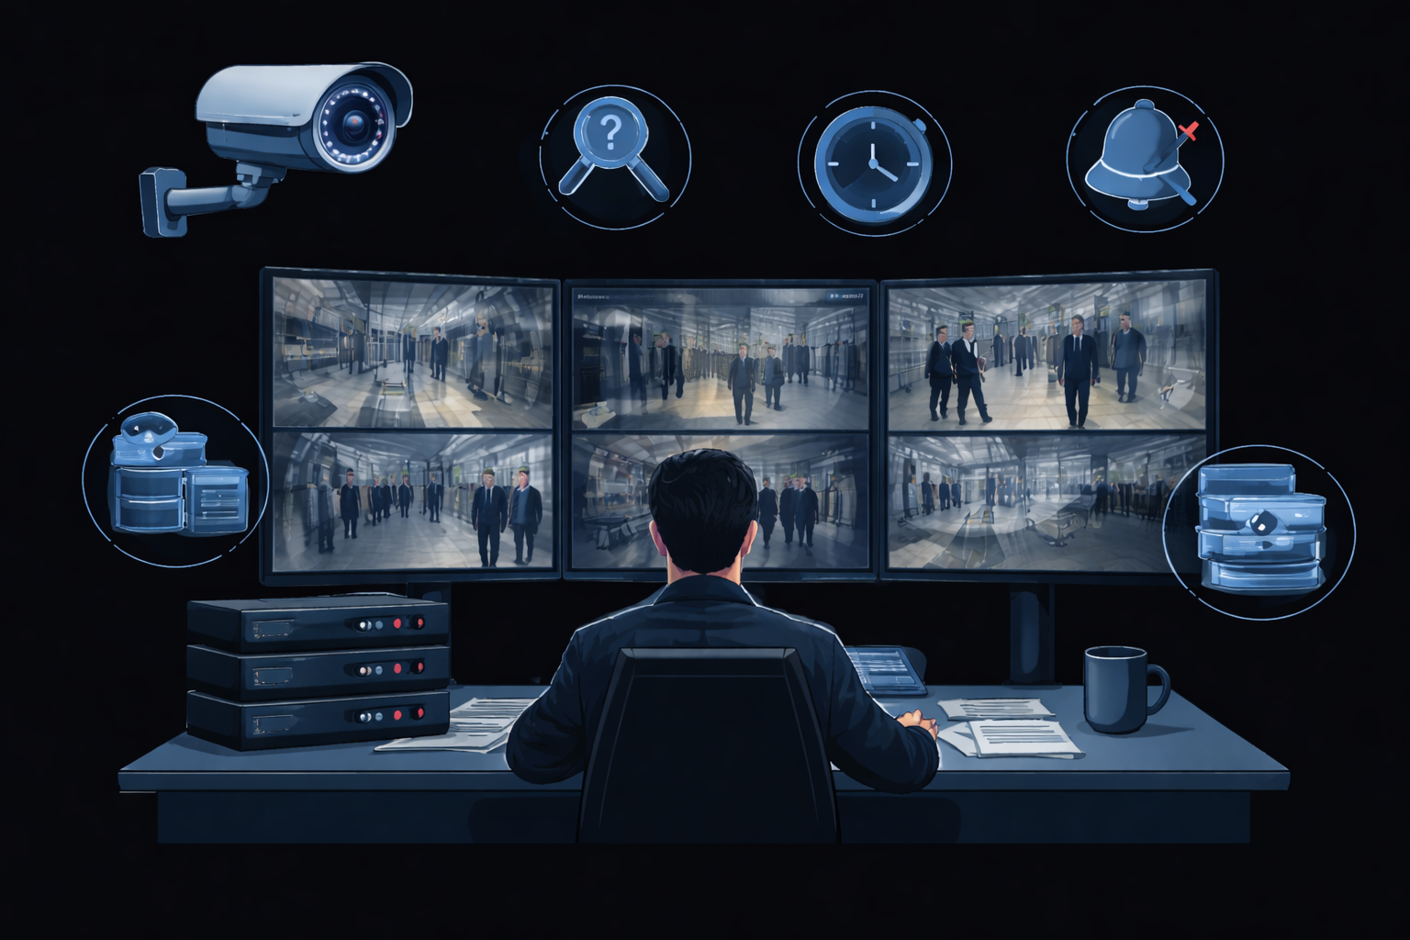
EXISTING SYSTEM
Traditional CCTV surveillance systems mainly focus on recording video footage for monitoring purposes. These systems require human operators to continuously observe multiple screens to detect suspicious activities or identify individuals. This manual monitoring process is time-consuming and increases the chances of human error.
Existing surveillance systems do not provide automatic face recognition or identification. When a specific person needs to be identified, security personnel must manually search through large amounts of recorded video. This process becomes difficult, especially in crowded environments where multiple faces appear simultaneously.
Moreover, traditional CCTV systems do not maintain an intelligent database for matching detected faces. They lack automated alert mechanisms and real-time identification capabilities. As a result, identifying individuals becomes slow and inefficient, reducing the effectiveness of surveillance systems.

Slide 6
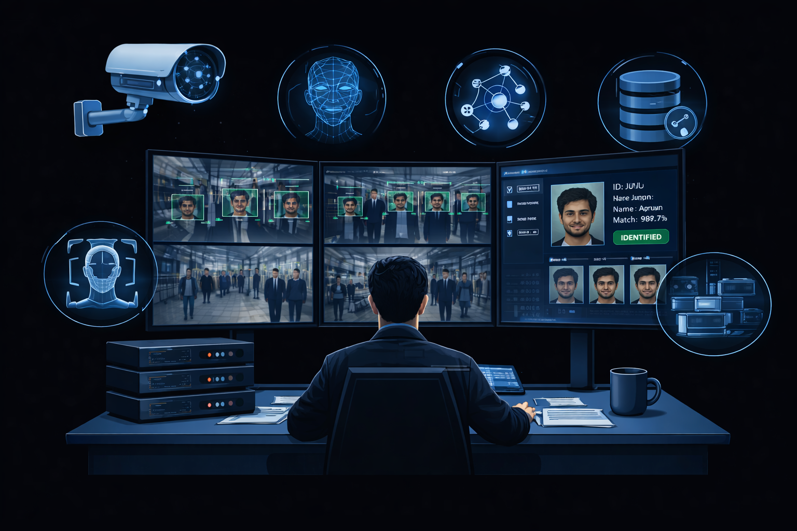
PROPOSED SYSTEM
The proposed system introduces an intelligent face recognition solution for analyzing CCTV footage automatically. The system detects faces from video frames and recognizes individuals using the Face Net deep learning model. The detected faces are compared with stored images in the database to identify known persons.
The system extracts frames from CCTV video, performs face detection, and generates facial embeddings using Face Net. These embeddings are then matched with the database using similarity comparison. When a match is found, the system displays the identified person's details such as name, ID, and other information. If no match is found, the system labels the person as unknown.
The proposed system reduces manual monitoring, improves identification accuracy, and enables faster search of individuals in surveillance footage. It also provides an interactive interface that highlights detected faces and displays information when the user hovers over the identified person.

Slide 7
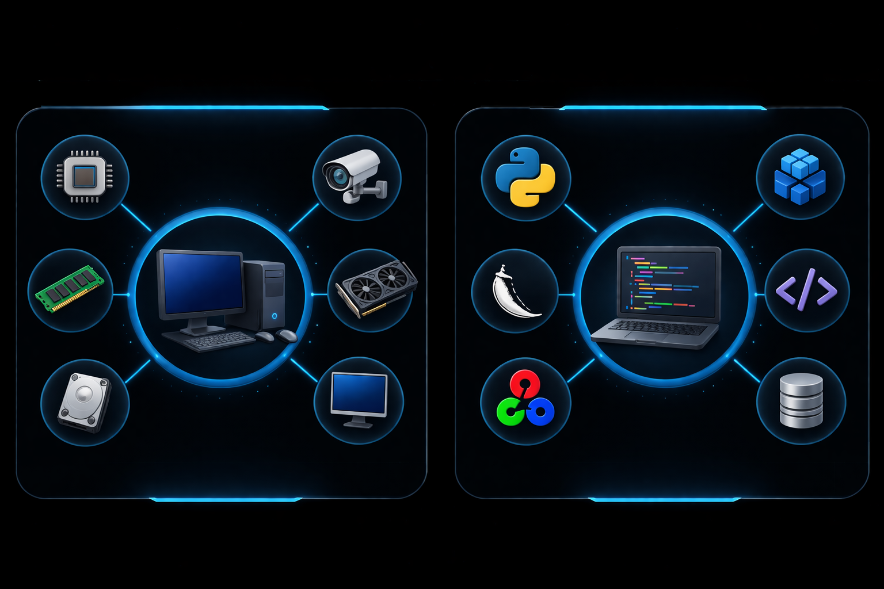
HARDWARE AND SOFTWARE REQUIREMENTS
The proposed system requires standard computing hardware to process CCTV video and perform face recognition. A system with a minimum Intel i5 processor is recommended to handle video processing and face detection efficiently. At least 8 GB RAM is required to support image processing and deep learning operations.
The system requires sufficient storage space to store video files, extracted frames, and database images. A minimum of 256 GB hard disk is recommended. A CCTV camera or recorded video input is required for surveillance data. A monitor is needed to display detection results and recognized faces. A GPU is optional but recommended for faster face recognition and improved performance.
The proposed system is developed using Python programming language due to its strong support for computer vision and deep learning libraries. The system uses Flask framework to build the web interface for uploading videos and displaying results. OpenCV library is used for video processing and face detection.
Face Net model is used for extracting facial features and performing recognition.
NumPy and Pandas libraries are used for data handling and processing. The frontend interface is developed using HTML, CSS, and JavaScript for displaying video frames and recognition results. SQLite or MySQL database is used to store face images and person details. The system can be developed using IDEs like Visual Studio Code or PyCharm.

Slide 8

LIST OF MODULES
1. Video Upload Module
This module allows the user to upload CCTV video files into the system. The uploaded video is stored temporarily and used for further processing. The system supports different video formats and prepares the video for frame extraction.
2. Frame Extraction Module
This module extracts frames from the uploaded CCTV video. The video is converted into multiple image frames at regular intervals. These frames are then passed to the face detection module for further analysis.
3. Face Detection Module
This module detects human faces from the extracted frames using computer vision techniques. It identifies face locations and draws bounding boxes around detected faces for further recognition.
4. Face Recognition Module
The face recognition module uses the Face Net model to extract facial features. It converts faces into embeddings and prepares them for comparison with stored database images.
5. Database Module
The database module stores registered face images and corresponding person details. It maintains the dataset used for recognition. The module retrieves stored data during comparison.
6. Matching Module
The matching module compares detected face embeddings with database embeddings. It calculates similarity scores and determines whether the person is recognized or unknown.
7. Result Display Module
The result display module shows recognition output on the screen. It highlights detected faces and displays details such as name, ID, and other information. Unknown persons are labeled accordingly.

Slide 9

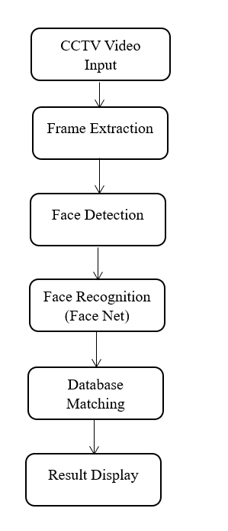
OVERALL ARCHITECTURE
The overall architecture of the proposed system consists of multiple modules that work together to perform face recognition from CCTV footage. The system takes CCTV video as input and converts it into frames. The frames are processed to detect faces using computer vision techniques.
The detected faces are then passed to the Face Net model for feature extraction. The extracted features are compared with stored database images. If a match is found, the system retrieves the person details and displays the result. Otherwise, the system labels the person as unknown.

Slide 10

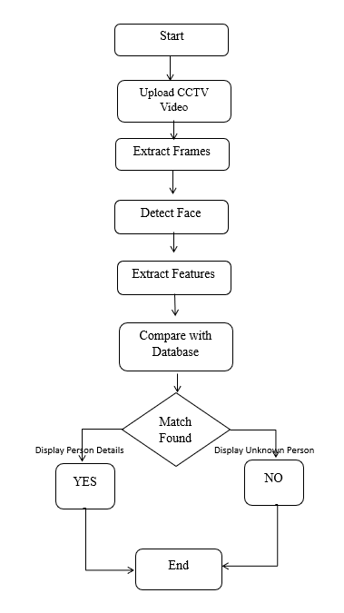
FLOW DIAGRAM
The flow diagram illustrates the working process of the proposed face recognition system. Initially, the system starts and the user uploads the CCTV video. The uploaded video is processed and converted into frames for analysis.
The system then detects faces from the extracted frames using face detection techniques. After detecting faces, facial features are extracted using the Face Net model. These features are compared with the stored database images.
If a match is found, the system identifies the person and displays the result. If no match is found, the system marks the person as unknown. Finally, the process ends after displaying the result.

Slide 11

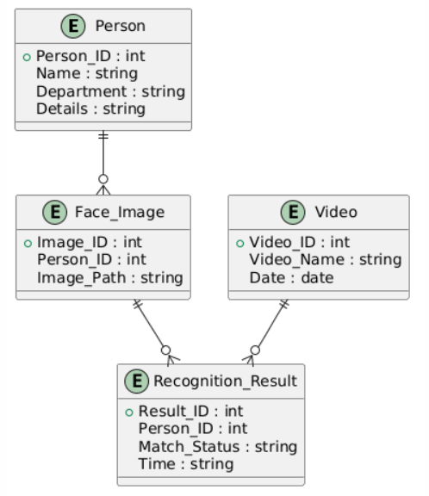
ER DIAGRAM
The ER diagram represents the database structure used in the face recognition system. The main entities in the system include Person, Face Image, Video, and Recognition Result. The Person entity stores details such as name, ID, and other information. The Face Image entity stores registered face images used for comparison.
The Video entity contains uploaded CCTV video details. The Recognition Result entity stores the output of the face recognition process. The Person entity is connected to Face Image, and the detected faces are matched with stored images. The Recognition Result entity stores matching details and identification status.

Slide 12

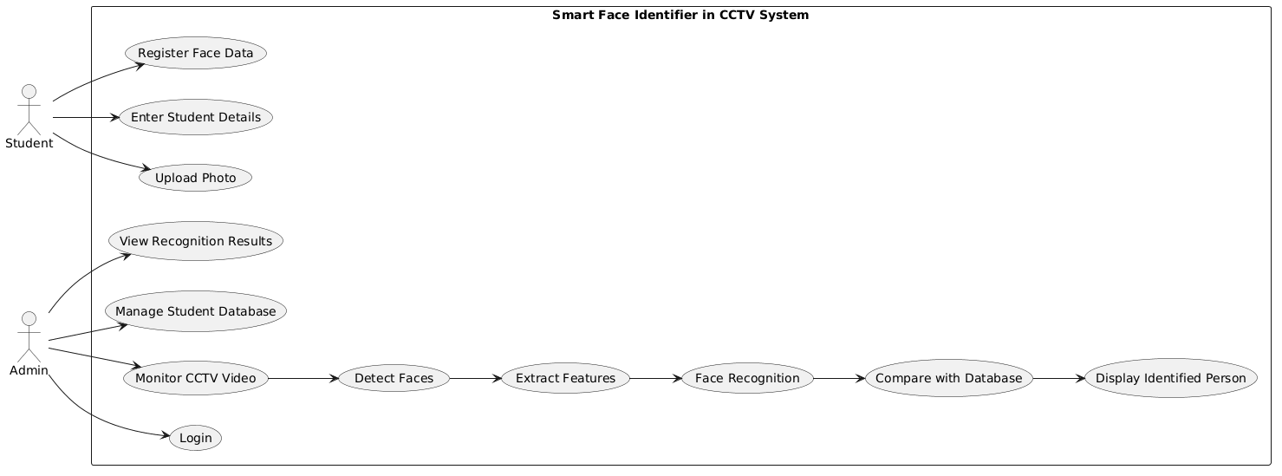
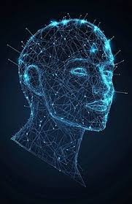
UML DIAGRAM
The UML diagram represents the interaction between the user and the system. The user uploads CCTV video into the system. The system processes the video and extracts frames. The face detection module identifies faces and sends them for recognition.
The system compares detected faces with database images and identifies the person. The results are displayed to the user. The admin can also manage database records such as adding and removing face images. The UML diagram helps in understanding system functionality.

Slide 13

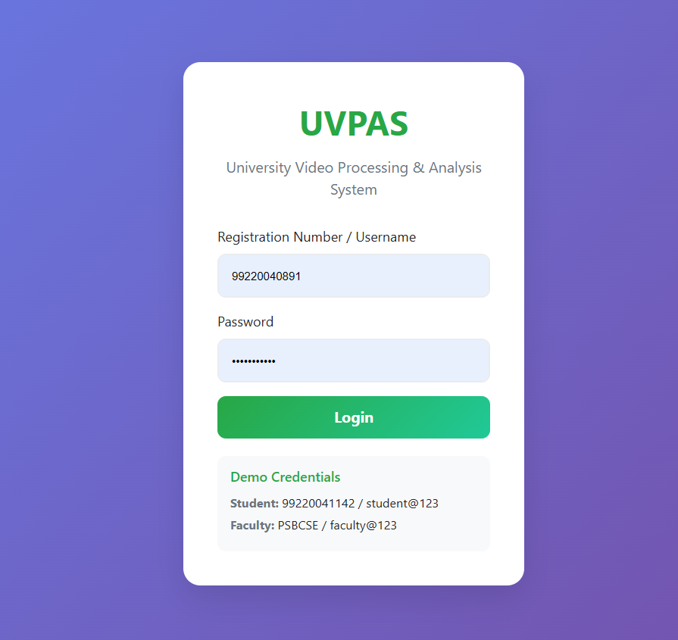
RESULTS AND DISCUSSIONS
System Login Module Result
The login module serves as the authentication gateway to the UVPAS platform. Users such as students and faculty must log in using their Registration Number/Username and Password.
The interface is designed with a clean and responsive layout that ensures secure access control. Demo credentials are also displayed to facilitate testing and evaluation.
Key observations:
Secure credential validation
Role-based login (Student / Faculty)
Password masking for privacy
Unauthorized access prevention

Slide 14

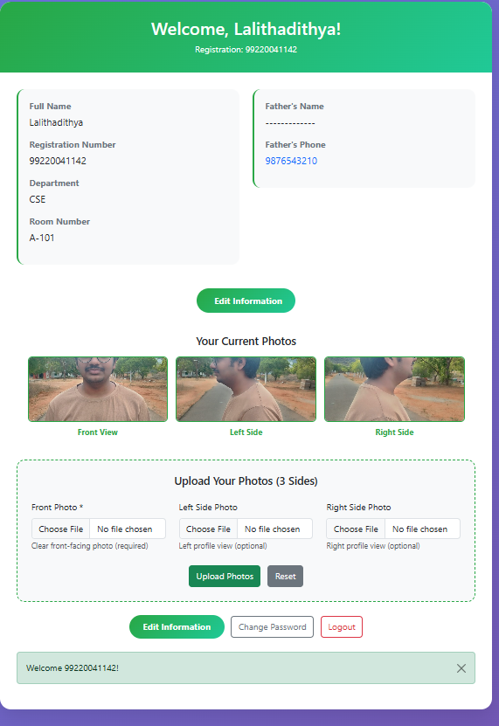
The student profile module allows users to register their personal details and upload facial images for recognition. The system displays information such as name, registration number, department, and contact details. Students can upload multiple face images including front view, left view, and right view.
These multi-angle images improve recognition accuracy by helping the system learn facial features under different orientations. The uploaded images are stored in the database and used for comparison during CCTV face recognition. This module acts as the dataset creation stage for the entire surveillance system.

Slide 15


The CCTV analytics dashboard allows administrators to upload recorded CCTV or mobile footage for automated face recognition. The system supports multiple video formats such as MP4, AVI, MOV, and MKV. Once the video is uploaded, the system automatically detects faces and performs recognition using the stored student dataset.
The dashboard also provides features such as live webcam monitoring, CCTV stream processing, gait gallery creation, and student management. Uploaded videos are processed and stored in the system, where detected faces are analyzed and identified. Additionally, Excel dataset management is provided to download, update, and synchronize student data efficiently.This module helps administrators monitor surveillance footage, manage datasets, and perform automated identification in a centralized interface.

Slide 16

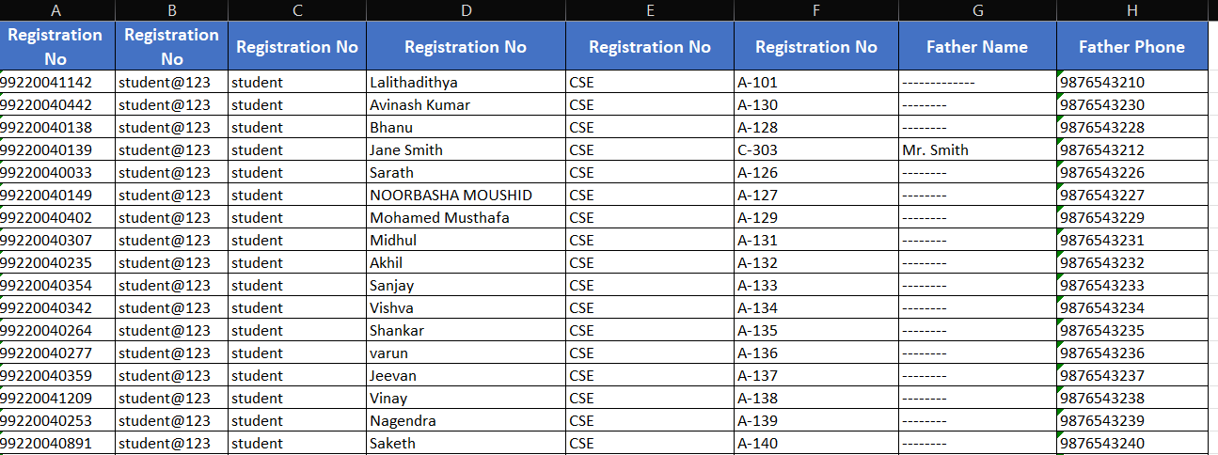
The Excel dataset management module allows administrators to handle student data efficiently using spreadsheet files. The system provides an option to download the complete student dataset, which includes registration number, login credentials, department, room number, and contact details. Administrators can edit this information offline in Excel, making it easier to update multiple student records at once.
After making changes, the updated Excel file can be uploaded back into the system, where the data is automatically synchronized with the database. This feature enables quick bulk registration of students, easy dataset correction, updating login credentials, and managing user roles. Overall, the Excel-based dataset management improves scalability, reduces manual data entry, and simplifies database maintenance for the surveillance system.

Slide 17
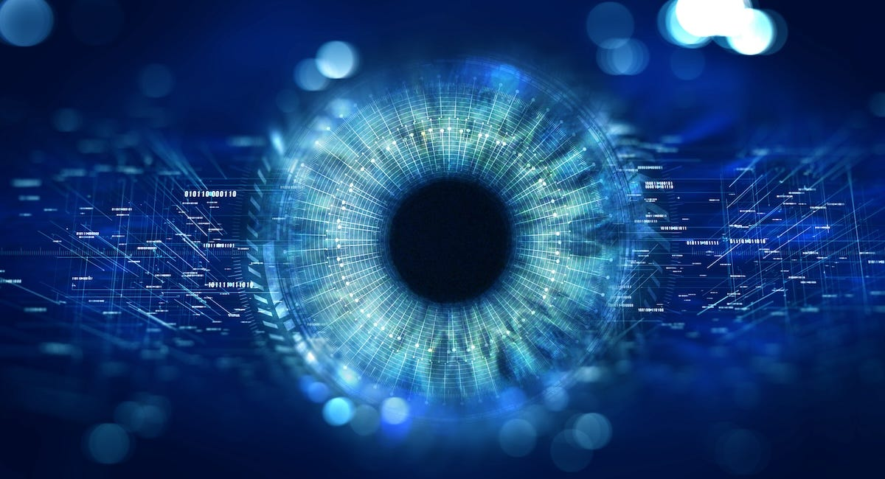
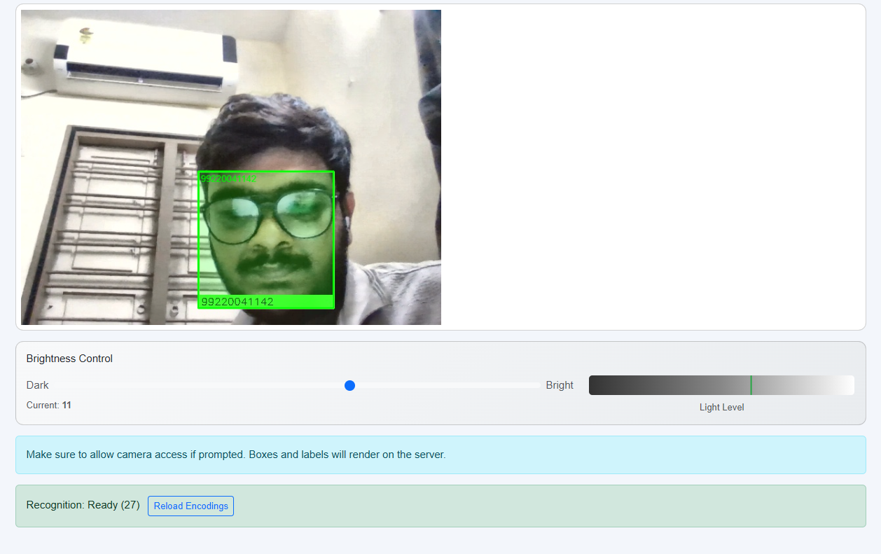
The real-time face recognition module captures live video from the webcam and detects faces automatically. Once a face is detected, the system extracts facial features and compares them with the stored student database. If a match is found, the system highlights the face using a green bounding box and displays the corresponding registration number.
The interface also provides brightness control to adjust lighting conditions for better detection accuracy. The recognition status indicates whether the system is ready and how many faces are loaded for comparison. This module enables live monitoring and instant identification of registered individuals, improving surveillance efficiency and real-time tracking.

Slide 18
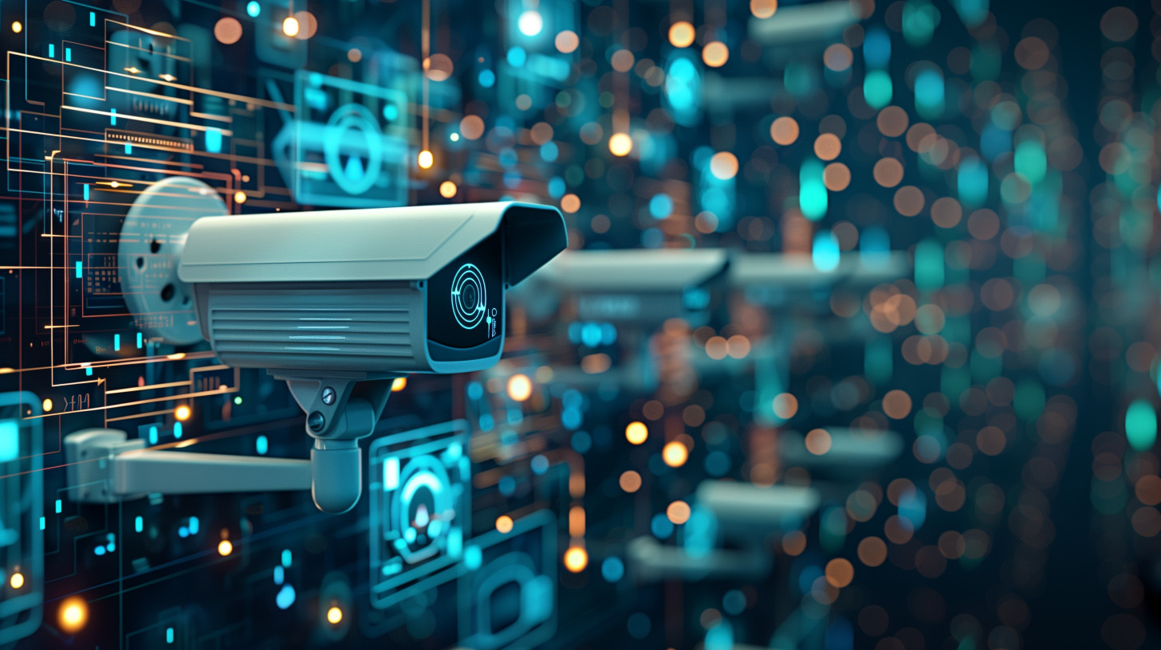
CONCLUSION
The AI-Based Face Recognition System for CCTV Surveillance was successfully developed to automate the process of identifying individuals from surveillance footage. The system integrates computer vision techniques with deep learning-based Face Net model to detect and recognize faces accurately. It allows students to register their facial data and enables administrators to monitor CCTV footage for identification.
The system processes uploaded video streams, extracts frames, detects faces, and compares them with stored datasets. Recognized individuals are displayed with their details, while unknown persons are labeled appropriately. The implementation of a web-based interface improves usability and enables centralized monitoring.
The developed system reduces manual effort, improves surveillance efficiency, and enhances security in institutional environments. The experimental results demonstrate reliable recognition accuracy, fast processing time, and effective database matching. The modular architecture also allows future scalability and easy integration with existing CCTV infrastructure.

Slide 19

FUTURE ENHANCEMENTS
The proposed system can be extended with several advanced features to improve performance and usability. Real-time CCTV streaming support can be added to continuously monitor surveillance cameras without uploading recorded videos. Alert notification mechanisms can be implemented to notify administrators when unknown persons are detected.
Cloud-based deployment can be introduced to store large datasets and enable remote monitoring from different locations. Mobile application support can also be developed for accessing surveillance results through smartphones. Multi-camera integration can be added to track individuals across multiple cameras.
Further improvements include enhancing recognition accuracy using advanced deep learning models, adding mask face recognition, and implementing attendance tracking features. The system can also be integrated with access control systems, criminal databases, and automated reporting modules. These enhancements will make the system more scalable, intelligent, and suitable for real-world deployment in smart surveillance environments.

Slide 20

REFERENCES
[1] Alhanaee, K., et al. (2021). Smart Attendance Tracking Using Convolutional Neural Networks and Deep Learning Techniques.
[2] Bugingo, E., et al. (2025). Improving Attendance Management through Face Recognition with Real-Time Facial Tracking.
[3] Sharma, P., & Sahu, A. (2022). Intelligent Attendance Management System Using Face Recognition and Machine Learning.
[4] DG HL, et al. (2020). Face Recognition based Attendance System.
[5] Wanjare, S. B., Mahajan, J. R., & Gadekar, S. S. (2024). Contactless Smart Attendance System Using Facial Recognition and QR Code.
[6] Li, H., et al. (2022Real-Time Student Attendance Monitoring Using Face Recognition with CNN and MTCNN.Procedia Computer Science, 199, 428–435.
[8] Rao, A. (2022). AttenFace: A Real-Time Student Attendance Management System Using Facial Recognition.
[9] Saraswat, D., et al. (2023). Contactless Attendance Monitoring System with Anti-Spoofing Mechanisms.
[10] Dixit, H. V. (2024). Automated Attendance System Using Face Recognition.

Slide 21

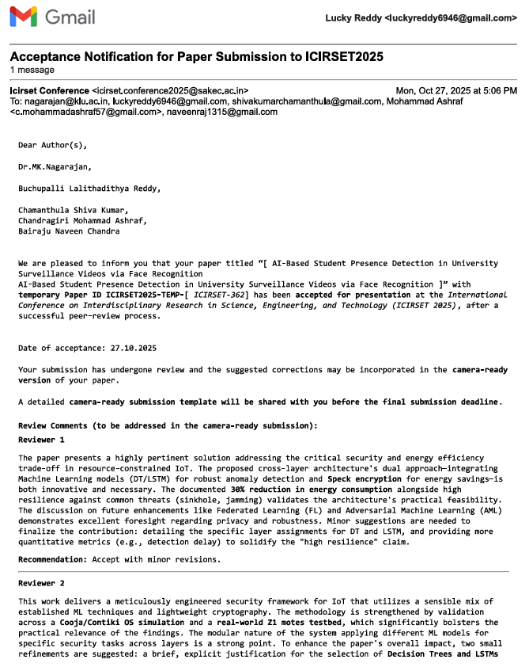
PUBLICATIONS

Slide 22







Slide 23


